Slide 2
Information system
Introduction
Thesis context
Increasingly used: number?
Used to acquire and diffuse information through the interaction with softwares and human
It raises a question about security of such systems (who, when, where information is accessible)
Hence, along with functional requirements, security concerns should be taken into account ASAP.

Slide 3
Model Driven Engineering
Introduction
Thesis context
Allows to build systems from different abstraction levels

Slide 4
Introduction
Thesis objective

Slide 5
System design
Introduction
Thesis motivation
Security requirements are coped simutulately with the functional ones
Variation of UML diagrams

Slide 6
Combination of graphical and formal notation
Introduction
Thesis motivation
Graphical notation (UML):
Intuative view
Inacdequate semantics
Facilatate the communication between stakeholders
Formal methods (Z, B, Alloy)
Precise semantics
Mathematical logic

Slide 7
Generation of application code
Introduction
Thesis motivation
From a proved specification of the system, how can I obtain its source code?
How to build a secure system which has a clear code for tracking and maintaining?

Slide 8
Secure information system development process
Introduction
Thesis contributions
System requirements diffinition
System design
System build
System implementation and testing
System maintain
UML model
B specification
B implementation
code

Slide 9
Outline
State of the art
Translation of UML into B
Translation of the B specification into AOP-based application
Tool support
Conclusion and future work
Notes:
For the rest of my presentation

Slide 10
Outline
State of the art
UML/OCL-based approaches
Alloy-based approaches
Z-based approaches
Translation of UML into B
Translation of the B specification into AOP-based application
Tool support
Conclusion and future work

Slide 11
State of the art
UML/OCL –based approaches

Slide 12
State of the art
Z –based approaches

Slide 13
State of the art
Alloy –based approaches

Slide 14
Conclusion
State of the art

Slide 15
Outline
Outline
State of the art
Translation of UML into B
Translation of the B specification into AOP-based application
Tool support
Conclusion and future work

Slide 16
Motivation
Translation of UML to B
Translation rules
Tool support: B4MSecure

Slide 17
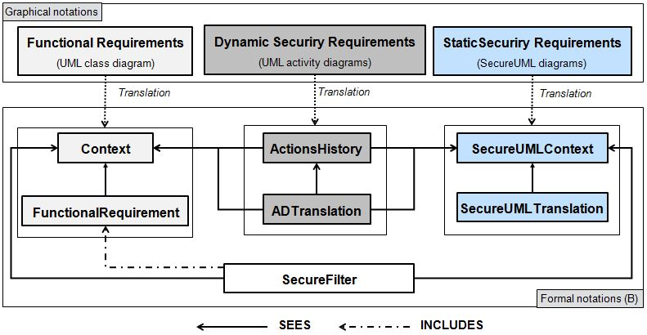
Formalize system-design models
Translation of UML to B

Slide 18
1. UML class diagram to B
Translation of UML to B
Mapping rules

Slide 19
2. SecureUML to B
Translation of UML to B
Mapping rules

Slide 20
3. UML activity diagrams to B
Translation of UML to B
Mapping rules

Slide 21
An access control filter
Translation of UML to B
Combining part

Slide 22
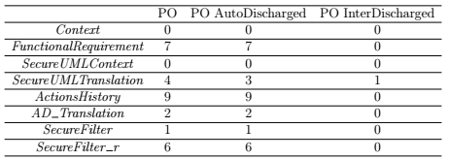
Proof obligations using AtelierB
Translation of UML to B
Validation

Slide 23
Outline
Outline
State of the art
Translation of UML into B
Translation of the B specification into AOP-based application
Tool support
Conclusion and future work

Slide 24
Motivation
Translation of B to JAVA/SQL/AspectJ

Slide 25
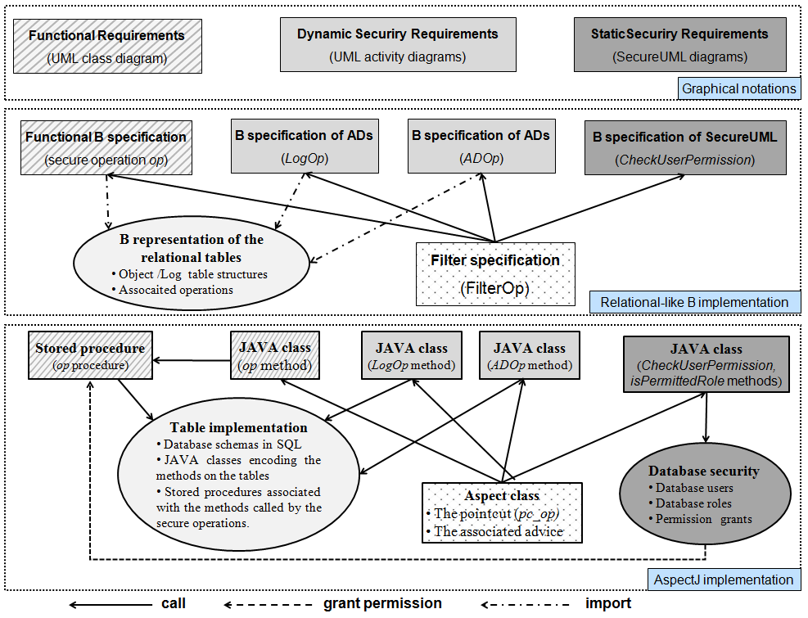
Translation of B to JAVA/SQL/AspectJ

Slide 26
Outline
Outline
State of the art
Translation of UML into B
Translation of the B specification into AOP-based application
Tool support
UML to B
B to JAVA/SQL
Conclusion and future work

Slide 27
Outline
Outline
State of the art
Translation of UML into B
Supporting business process configuration
Translation of the B specification into AOP-based application
Conclusion and future work

Slide 28
Conclusion
Conclusion and future work

Slide 29
Future work
Conclusion and future work

Slide 30
Publications
Thi Mai Nguyen, Amel Mammar, Regine Laleau and Samir Hameg, A tool for the generation of a secure access control filter, IEEE 10th International Conference on Research Challenges in Information Science, RCIS 2016, Grenoble, France, June 2016
Amel Mammar, Thi Mai Nguyen and Regine Laleau, Formal development of a secure access control filter, IEEE 17th International Symposium on High Assurance Systems Engineering, HASE 2016, Orlando, Florida, USA, January 2016.

Slide 31
Thank you for your attention!
Questions?

Slide 33
Business Process Variability
Introduction
Thesis context
Process model collections range up to thousands of process models with overlapped parts
How to manage the variability and enable the reuse of process models in Process-Aware Information Systems?
2 variants of a car rental process
Business Process
repository
Notes:
1.This thesis work is in the context of business process variability. The variability in business processes occurs when different processes are defined to describe the same procedure.
2.If we take for example these two variants of a car rental book process
They share the same activities, however the first one allows while the second
3.The main challenge that arises in this context is how to manege such variability and enable the reuse of process models in process-aware information systems

Slide 34
Configurable Process Models
Introduction
Thesis context
Allow an explicit representation of the common and variable parts of similar processes into one customizable model
Variation
point
Configuration
Individualization
Notes:
One possible solution is to use configurable process models. These models allow an explicit representation of the common and variable part of multiple process models into one customizable process
For example, this is a configurable process that show the commonalities and differences between the two car rental variants. The variation points modeled in red allow to explicitly identify the variable parts and we call them configurable elements.
This configurable process cannot be executed as it is. It needs to be configured to the specific needs of a company. For example, if a company doesn’t have the online car booking it blocks this outgoing path of the variation point.
Once all the variation points have been configured, an individualized process variant is derived that doest include any variation point and can now be executed.

Slide 35
Configurable Process Models: lifecycle
Introduction
Thesis objective
Objective: Automated support for:
Configurable process design and
Configuration phases
Process diagnosis
Process design
Process implementation
Process execution
Process diagnosis
Configurable Process design
Process implementation
Process execution
Configuration & individualization
Traditional BPM lifecycle
Notes:
According to the traditional business process lifecycle, the process design phase is replaced by two steps the design and the configuration of the configurable process.
Our objective in this thesis is to support these two phases.
In the following I am going to present two motivating examples to illustrate each of our two sub-objectives

Slide 36

1. Configurable Process Design
Introduction
Motivation
I want to design a configurable travel booking process
Process provider
Which configurable fragments are appropriate to this position?
An ongoing design of a configurable travel booking process
Notes:
Suppose that a process designer that we name process provider wants to design a configurable travel booking process. He starts by sketching out some activities which are well known in this domain as select a flight, request credit card info and send emain confirmation. At this stage, he needs to expand this process to integrate the configurable parts. For example he wants to expand the process part that contains the activity request credit card info
The main question here is which configurable fragments are appropriate to this positions

Slide 37

1. Configurable Process Design
Introduction
Motivation
Merger
Extract fragments
Existing flight and hotel reservation processes
Notes:
In our approach, we propose to leaen from previous experience in process modeling to assist the process provider
We suppose that there exist business processes for flight and hotel reservation
The process provider selects the activity for which he wants to discover a configurable fragment
We search for this activity in existing business processes, we extract the fragments arounding it and we propose to merge them into configurable fragments

Slide 38
1. Configurable Process Design
Introduction
Motivation
A recommended configurable fragment
Notes:
The result of this step is one or multiple configurable fragments, that contain the selected activity with its connections to the activities’ neighbors through configurable elements

Slide 39

2. Business Process Configuration
Introduction
Motivation
OK! I will create a configuration support system
You can now configure this process according to your needs
Process provider
How can I configure this process to fit my organizations’ needs?
Process user
Notes:
Once the provider completes the design of his configurable process models, he can deliver it to different companies that we refer to them by process user to start configuring it.
However, it is well known in the literature that configurable process models are large and complex ones, so process users need assistance to select the configuration choices. And now the process provider proposes to create a configuration support system to assist the process user.

Slide 40
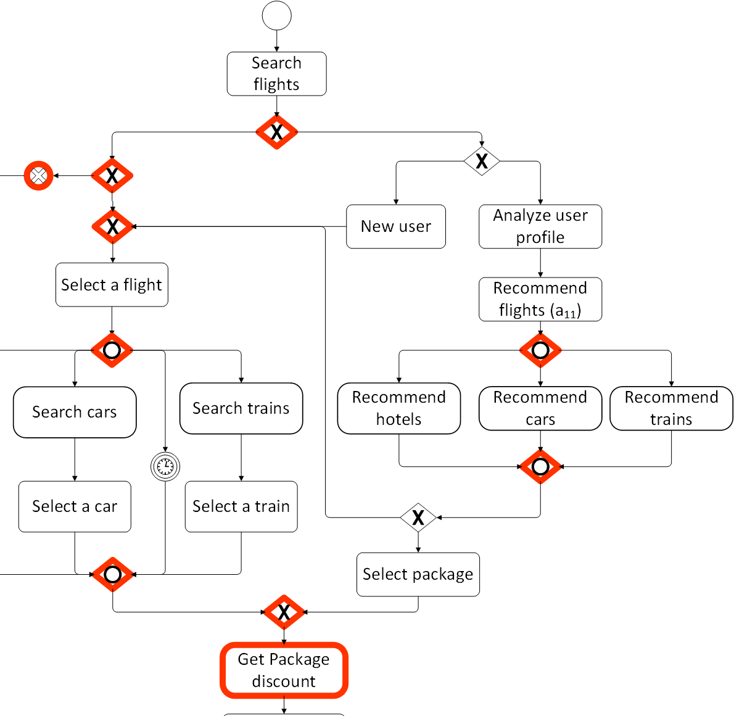
2. Business Process Configuration
Introduction
Motivation
Configuration Support System = Which configuration choices should be recommended and in which order ?
If you don’t have a search trains option
We recommend you to remove the Recommend trains option
If you don’t have a recommendation functionality
We recommend you to remove the Discount package offer

Slide 41
2. Business Process Configuration
Introduction
Motivation
Configuration Support System = Which configuration choices should be recommended and in which order ?
We recommend you to configure first this variation point
1
Then this one
3
2
Thereafter this one

Slide 42
Thesis Research Problem
Introduction
Research problem
Process provider
1. For assisting configurable process design:
1.1 How to identify fragments that are close to process provider interest?
1.2 How to derive configurable fragments?

Slide 43
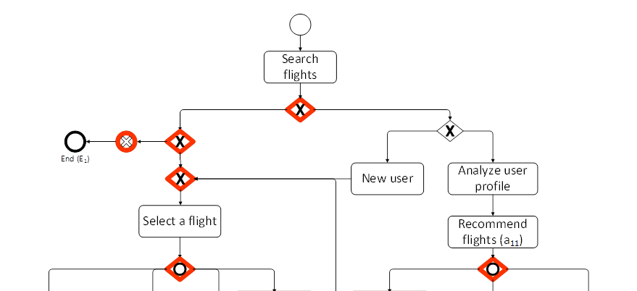
Thesis Research Problem
Introduction
Research problem
?
?
?
?
Process provider
2. For supporting business process configuration:
2.1 How to recommend configuration choices?
2.2 How to propose an order for the configuration of the variation points?

Slide 44
Thesis Principles
Introduction
Principles
P1: Automation
Merging and mining algorithms, data mining and graph theory techniques
P2: Implicit knowledge exploitation
Using designed process models or event logs
P3: Focused results
Recommending fine-grained results
P4: Balanced computation
Not too complex

Slide 45
Helicopter View
Introduction
Thesis contributions
Inputs – Contributions – Outputs
Process provider
Process user
Configurable fragments for selected positions in the process
Interactive configuration assistance

Slide 46
Outline
Outline
State of the art
Assisting configurable process design
Supporting business process configuration
Assisting configurable process design
Supporting business process configuration
Combined approach using event logs
Validation
Conclusion and future work

Slide 47
Configurable process design
State of the art
Assisting configurable process design
Configurable process modeling: (C-EPC [101, 141, 149, 202], C-BPMN [74, 78, 79, 111, 139, 153, 157, 207], C-UML [140])
Configurable activities/connectors, hiding/blocking operators, change operations, model annotations, model projection
Business process variant retrieval: (Similarity search [13, 15, 50-52, 59, 94, 97, 110, 196, 203], retrieval algorithms [55, 60, 98, 118, 211])
Not configurable
Business process merging: ([47, 71, 99, 102, 109, 127, 143, 159, 168]) Business process mining: ([72, 32, 159, 198])
Easily confused
Computational complexity
Notes:
For assisting configurable process design, three main research axes exist in the literature.
The first one is the development of configurable approaches and process modeling languages. Example of these approaches are the use of configurable elements in the process, the use of hiding and blocking operators, change operations and so on. In our work, we adopt the approach that uses configurable elements as it provides an integrated set of all possible process configurations into one model and therefore is suitable for process reuse.
The works in the second axis propose to retireve different variants of the same process from a process repository. Here, similarity metrics and retireval algorithms are developed. However, these approaches dot not recommend configurable models.
In the third axis merging and mining approaches are proposed to construct a configurable process model from a set of retrieved variants. However, all of these approaches construct the configurable process at once. The resulted models can be very large and complex which can easily confuse the user and also they are computationally complex

Slide 48
Synthesis
State of the art
Assisting configurable process design
Current approaches:
Merge or mine entire business process models.
Recommend complex and large models
Face computational complexity
Approaches | Automation | Focused results | Implicit knowledge | Balanced computation
[102,47] | + | - | + | +/-
[44] [90,120] | + | - | - | +/-
[127] | +/- | - | - | +/-
[143] | - | - | - | +/-
[99] | +/- | - | + | +/-
Process mining [72, 32, 159, 198] | + | - | + | +/-
Process Merging
Notes:
This table summarizes the approaches and how they fulfill each of our identified principles. Only the merging and mining approaches are represented here as the configurable process modeling languages and the variant retrieval approaches can be considered as prerequsite.
From this table we can see that none of the approaches return focused results. They all construct the configurable process model at once so they return large and complex results. They all use heuristics to face the computational complexity which is still complex. Almost all of them are automated or semi automated and they use the implicit knowledge to derive configurable processes.

Slide 49
Business process configuration
State of the art
Supporting process configuration
Domain-based approaches: (Questionnaires [103, 104], feature models [16,22,76,145], Goal-driven [105], Ontologies [85], Consistency graphs [44])
Manual (except [44])
Lack configuration recommendation [44]
Process-based approaches: ([32,47,78,79,88,96,102,141,149,198])
Manual (except [102, 47, 32, 198, 73])
Not focus [102, 47, 32, 88, 198]
Lack configuration steps assistance
Notes:
Regarding our second objective, we have assessed the approaches that propose a support for process configuration.
We found that they can be split into two categories:
In the first category, domain-based models are created to provide configuration guidance.
The main idea here is that these domain-based models abstract from the technical detail of configurable process models and depict their variability in an abstract manner. However these models are currently manually created by domain experts which is both time consuming and error prone. The only automated approach we found for constructing the domain-based model do not provide recommendation on the configuration choices.
In the second category, the guidance is provided directly on the process model. Also in most of these approaches, the recommendations are manually identified. Those that are automated recommend entire process variants instead of focused results and they do not provide a step by step assistance

Slide 50
Synthesis
State of the art
Supporting process configuration
Approaches | Automation | Implicit knowledge | Focused results | Balanced computation
[104, 103] | - | - | + | manual
[22, 145, 76, 16, 139] | - | - | +/- | manual
[44] | +/- | + | +/- | manual
[85, 149, 141, 105] | - | - | +/- | manual
[78, 79, 96] | - | - | + | manual
[102, 47, 32, 198, 73] | + | - | +/- | +/-
Current approaches:
Require an expensive manual work
Do not explore the knowledge resulted from previous configurations
Domain
Process
Notes:
This table summarizes the approaches and how they fulfill each of our identified principles.
we can see that none of the approaches fulfill all of our identified principles. Most of them are manual and require expensive work.
Only one approach uses the implicit knowledge in the configurable process However none of them use the implicit knowledge resulted from previous configurations.
Their results are not always focus, because they either do not recommend configuration choices or do not provide a step by step assistance.

Slide 51
Conclusion
State of the art
Assisting configurable process design:
Large and complex models
Graph-based merging and mining algorithms: La Rosa et al. (2013), Derguech et al. (2011), Joos et al. (2013)
Supporting business process configuration:
Manual
Automation: Verbeek et al. (2015)
implicit knowledge in the configurable process model
Implicit knowledge resulted from previous configurations
Notes:
To sum up, in our approach we want to avoid the recommendation of large and complex models for configurable process design. We have been inspired from the merging and mining approaches that are prposed for graph-based representation of process models
For supporting process configuration, we want an automated approach. The only automated one proposed by Verbeek et al tries to infer a domain-based model from a configurable process model. In our approach we want to use the implicit knowledge resulted from previous configurations in order to integrate the user experience in process configurartion

Slide 52
Outline
Outline
State of the art
Assisting configurable process design
Supporting business process configuration
Combined approach using event logs
Validation
Conclusion and future work

Slide 53
Motivation
Assisting configurable process design
Process providers need assistance to complete the missing parts in an ongoing configurable process design
They need to find configurable fragments for selected positions in the process
To complete or replace some parts
To extend a designed configurable process
→ We propose to recommend configurable process fragments for a selected activity in the process

Slide 54
Helicopter view
Assisting configurable process design

Slide 55
Neighborhood Context Graph
Assisting configurable process design
Business process fragment that includes an associated activity and the closest relations to its neighbors [chan, 2012]
Neighbors are located on virtual
layers

Slide 56
Deriving configurable fragments
Assisting configurable process design
BP database
Request credit card info
input
Search for similar activities in all processes
Extract their neighborhood context graphs from each process
Cluster similar fragments (graph edit distance)
Merge each cluster into a configurable fragment

Slide 57
Merging algorithm
Assisting configurable process design
Match and merge activities on the same layer
Match edges and merge their labels: Connection flow alignment
Add unmerged activities and edges
Convert to C-BPMN

Slide 58
Conclusion
Assisting configurable process design
We answer the first thesis research problem:
1.1 How to identify configurable process fragments?
Neighborhood context graph
1.2 How to derive configurable fragments?
Extract, cluster and merge neighborhood context graphs
We respect our principles:
Automated approach for deriving configurable fragments (P1)
Exploit activity neighborhood in process models (P2)
Recommend focused configurable fragments (P3)
Do not face the computational complexity problem (P4)

Slide 59
Outline
Outline
State of the art
Assisting configurable process design
Supporting business process configuration
Configuration guidance model
Extracting configuration guidelines
Deriving configuration steps order
Combined approach using event logs
Validation
Conclusion and future work

Slide 60
Motivation
Supporting process configuration
Process users need assistance to configure the process
They need:
Recommendations on the configuration choices and
Recommendations on the order in which the configurable elements are configured
Process providers create configuration support systems to answer process users’ needs
→ We propose to automate the creation of configuration guidance models

Slide 61
Helicopter view
Supporting process configuration

Slide 62
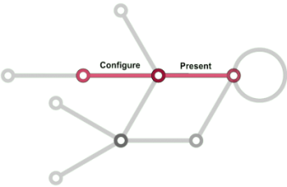


Approach
Supporting process configuration
What exists is manual
What we want is automated support
Domain-based
Configuration Support System
Process provider
Domain expert
Configuration steps order
Manual Mapping
Configuration guidelines

Slide 63


Approach
Supporting process configuration
Learn from previous experience in process configuration
Configurable BP
Configuration Guidance Model
Configuration steps order
Configuration guidelines
BP repository

Slide 64
Configuration Guidance Model
Supporting process configuration
1. Configuration steps order
2. Configuration guidelines
Root
Variant1
Variant5
Variant2
VP1
VP2
VP3
VP4
VP5
VP6
VP7
<includes>
Variant3
Variant4
Variant6
<excludes>

Slide 65


Configuration guideline
Supporting process configuration
Is an association among different configuration choices: if..then rule
Package discount → Car rental + hotel reservation
Notes:
As a definition a configuration guideline is an association among different configuration choices. It is in the form of if.. Then rule. For example this configuration guideline means that if the package discount activity is included in the process, then the car rental and hotel reservation are also included

Slide 66
Extracting configuration guidelines
Supporting process configuration
Configurable BP
Retrieve similar configurations from all process models (similarity metrics)
Create a configuration matrix
Mine configuration guidelines using an existing Association Rule Mining algorithm (Apriori)
input
BP repository
output
A list of configuration guidelines:
VP1=Variant1 → VP2 = Variant2 (Support =0.5 , Confidence=0.7)
VP2= Variant2, VP3 = Variant3 → VP4 = Variant4 (S=0.6, C=0.8)
Notes:
To extract these guidelines we propose a three steps approach
Our inputs is the cnfigurable process for which we want to extract the guidelines and a repository of existing business process models
The output is a list of configuration guidelines. Each guideline has two parameters support and confidence. The support expresses the probability of selection of the configurations in the guideline together. The confidence expresses the certainty of the guideline which means the probability of selecting the configurations in the right hand side of the guideline having the configurations in the left hand side selected
In the first step, we extract the configurations of the variation points in the configurable process from the BP repository and it is based on a similarity value
In the second step we stock the extracted configurations in a data structure called configuration matrix
And last , the configuration guidelines are derived using Apriori, an existing algorithm from Association rule mining field

Slide 67
Extracting configuration guidelines
Supporting process configuration
Configuration matrix is a n x m matrix
Configurable elements
A
OR
E
F
P₁
P₂
P_{n}
Best matching
BP repository
From each process
Notes:
The configuration matrix in which we stocke the extracted configurations is a n by m matrix. The columns correspond to the configurable elemenbts in the configurable process
The lines correspond to the business processes in the process repository
Each entry correspond to one possible element’s configuration retrieved from a process model

Slide 68
Configuration Guidance Model
Supporting process configuration
1. Configuration steps order
2. Configuration guidelines
Root
Variant1
Variant5
Variant2
VP1
VP2
VP3
VP4
VP5
VP6
VP7
<includes>
Variant3
Variant4
Variant6
<excludes>

Slide 69
Deriving configuration steps order
Supporting process configuration
Derive Implication Graph for Variation Points from extracted configuration guidelines
VP1 = Variant1 → VP2 = Variant2 P(Variant2|Variant1) = confidence
VP2= Variant2, VP3 = Vatiant3 → VP4 = Variant4 P(Variant4|Variant2,Variant3)
Configuration steps order → derive optimal spanning tree from Implication Graph

Slide 70
Conclusion
Assisting configurable process design
We answer the second thesis research problem:
1.1 How to recommend configuration choices?
extract configuration guidelines from process models using Association Rule Mining
1.2 How to identify the order of elements’ configuration?
Infer an order from the configuration dependencies using Graph Theory
We respect our principles:
Automated approach for creating configuration support systems (P1)
Use configuration knowledge hidden in process models (P2)
Recommend step by step configuration (P3)
Reasonable computational complexity (P4)

Slide 71
Outline
Outline
State of the art
Assisting configurable process design
Supporting business process configuration
Combined approach using event logs
Mining configurable fragments
Mining configuration guidelines
Validation
Conclusion and future work

Slide 72
Motivation
Combined approach using event logs
Process models do not always exists.
Process event logs exist in all information systems.
They present the reality of the business process execution.
They contain useful information for process design and configuration
→ We propose to mine configurable fragments and configuration guidelines from event logs

Slide 73
Helicopter view
Combined approach using event logs

Slide 74





Mining configurable fragments
Combined approach using event logs
Collection of event logs
Extract log-based neighborhood context
1
2
Identify configurable elements
Mine a fragment
3

Slide 75
Mining configuration guidelines
Combined approach using event logs
Configurable BP
Extract the executions of the configurations
Build the frequency-based suffix tree
Compute the frequency of each configuration
Rank the configurations
Input
&
Event logs
Output
Ranked configuration guidelines
VP1=Variant 1 → VP2 = Variant2 (high)
VP1=Variant 1, VP2 = Variant2 → VP3 = Variant3 (medium)
Notes:
Taking into account the previously selected ones

Slide 76
Outline
Outline
State of the art
Assisting configurable process design
Supporting business process configuration
Combined approach using event logs
Validation
Proof of concepts
Experiments
Case study
Conclusion and future work

Slide 77
Outline
Outline
State of the art
Assisting configurable process design
Supporting business process configuration
Combined approach using event logs
Validation
Proof of concepts
Experiments
Case study
Conclusion and future work

Slide 78
Proof of concepts
Validation
Proof of concepts
Objective:
To show the practical application of our approach
To show that our approach is feasible
Applications | Technologies | Framework | Classes | LOC
Configurable process design | JAVA, JavaScript, MySQL | Signavio | 25 | 4185
Business process configuration | JAVA, JavaScript, MySQL | Signavio | 18 | 1239
Combined approach using event logs | JAVA | ProM | 5 | 501
Notes:
To show the feasibility and applicability of our approach, we have developed proof of concepts as extensions to Signavio and Prom which are open source tools used by the business process management community
Three proof of concepts

Slide 79
Signavio extension
Validation
Proof of concepts
Business process configuration
http://www-inf.telecom-sudparis.eu/SIMBAD/tools/confRule/

Slide 80
Outline
Outline
State of the art
Assisting configurable process design
Supporting business process configuration
Combined approach using event logs
Validation
Proof of concepts
Experiments
Case study
Conclusion and future work

Slide 81
Experiments
Validation
Experiments
Objective:
To evaluate the feasibility of our approach,
To evaluate the quality and accuracy of our results,
To observe the impact of parameters,
And to measure the performance of our approach
Datasets:
Configurable process design: dataset shared by the Cognitive Computing and Industry Solutions research group at the IBM Zurich Research Laboratory (560 processes)
Business process configuration: SAP reference model (604 processes)
Notes:
For time limitation, I am going to show only some of the results of the experiments

Slide 82
Configurable process design experiments
Validation
Experiments

Slide 83
Approach feasibility
Validation
Experiments
Statistics on the nb of extracted and recommended fragments
For different layers K
Conclusion: Our approach is feasible
 | Min. |  |  | Max. |  |  | Avg.
 | K=1 | K=2 | K=3 | K=1 | K=2 | K=3 | K=1 | K=2 | K=3
Nb. extracted frag. | 6 |  |  | 65 |  |  | 8
Nb. configurable frag. | 1.2 | 1.89 | 2.05 | 4.67 | 7.12 | 10.55 | 1.55 | 2.58 | 3.45
Notes:
To show that our approach is feasible we have computed the nb of extracted fragments and the number of recommended configurable fragments for different Layer numbers of the neighborhood context graph
We found that in average we extract 8 fragments for a selected activity. These fragments are clustered and then in average we recommend between 2 and 3 fragments

Slide 84
Configurable fragments quality
Validation
Experiments
Reduction in size (Compression factor)
Impact of parameters (layers K and Clustering step)
Conclusion: good quality with clustering step and small layers’ number
 | Min. |  |  | Max. |  |  | Avg.
 | K=1 | K=2 | K=3 | K=1 | K=2 | K=3 | K=1 | K=2 | K=3
Compression factor (without clustering) | 0.38 | 0.14 | 0.13 | 0.81 | 0.72 | 0.7 | 0.44 | 0.33 | 0.26
Compression factor (with clustering) | 0.56 | 0.5 | 0.42 | 0.92 | 0.85 | 0.83 | 0.61 | 0.52 | 0.45
Notes:
To asses the quality of our recommended configurable fragments, we have computed their reduction in size. For that we computed the compression factor metric. A compression factor close to 0.5 means that the configurable fragment size is half the sizes of the merged fragments and so it is a concise representation.
We studied two cases with and without the clustering step
We found that with the clustering step the fragments are of high quality. If we take for example the average . This is because, with the clustering step only similar fragments are merged.

Slide 85
Process configuration experiments
Validation
Experiments

Slide 86
Approach feasibility
Validation
Experiments
Statistics on the nb of extracted guidelines
For different support values
Conclusion: Our approach is feasible
Nb. guidelines | Min. | Max. | Avg.
S=0.01 | 2 | 7.5 x 10² | 101.7
S=0.05 | 2 | 6 x 10² | 92.32
S=0.1 | 2 | 123 | 40.56
S=0.3 | 0 | 30 | 10.7
S=0.5 | 0 | 10 | 5.2

Slide 87
Results quality
Validation
Experiments
Complexity and the completeness of the configuration guidelines
For different support values
Complexity and completeness are negatively correlated with Support
Conclusion: A trade-off between complexity and completeness
Notes:
We plotted the complexisty againt the completeness for different support values
Both the

Slide 88
Synthesis
Validation
Experiments
Experimental results showed that:
High quality with small parameters values (small layer numbers, support and confidence values)
Our approach is:
Feasible
of good results’ quality and
of good performance

Slide 89
Outline
Outline
State of the art
Assisting configurable process design
Supporting business process configuration
Combined approach using event logs
Validation
Proof of concepts
Experiments
Case study
Conclusion and future work

Slide 90
Case study for process configuration
Validation
Case study
Objective: To show the practical usefulness of our configuration support approach
Formulated questions:
Q1: How our approach can be useful when combined to existing ones?
Q2: Does our approach provide sufficient and necessary information?
Hypothesis to validate:
H1: It saves time and facilitates the creation of configuration support systems (CSS)
H2: It recommends additional configuration guidelines that were unknown according to the domain expert knowledge

Slide 91
Design & Execution
Validation
Case study
Configurable business process: A service supervision process adopted by Orange
Population: 20 participants, professional (engineers in SOA) and academics (from BPM and SOA fields)
3 hours Workshop to introduce different configuration notions

Slide 92

Design & Execution
Validation
Case study
1
2
Configure the
process
Stock variant
Configurable business process
Generate configuration guidance model (CGM)
Create a configuration support system (CSS)
3
4
Group G
Group GA
Build CSS without CGM
Build CSS with CGM

Slide 93
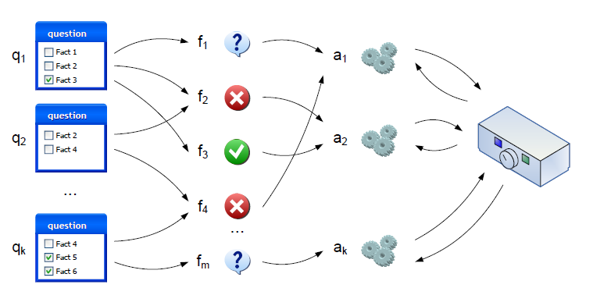
Design & Execution
Validation
Case study
CSS: We use questionnaire models (La Rosa et al, 2008)
1
2
3
Mapping:
Questions → configurable elements
Answers → configuration choices
Identify questions and order between them
Identify answers and relations (constraints) among them

Slide 94
Results
Validation
Case study
Time (man-hour) needed to create the CSS:
H1: Our approach saves time and facilitates the creation of configuration support systems
30% of additional constraints → reflect the past users behavior
H2: Our approach recommends additional configuration guidelines that were unknown according to the domain expert knowledge
 | questions | Order dependencies | Domain constraints | mapping
G | 2 | 4 | 5 | 1
GA | 2.5 | 2 | 1 | 0.5
Notes:
We did not compose the guidelines

Slide 95
Outline
Outline
State of the art
Assisting configurable process design
Supporting business process configuration
Combined approach using event logs
Validation
Conclusion and future work

Slide 96
Conclusion
Conclusion and future work
Conclusion
We proposed an approach for an automated support of configurable process models
For assisting configurable process design:
Input | Output
Process models Event logs | Configurable fragments for selected positions in the process
Contribution
We proposed two approaches for deriving configurable fragments (by merging process fragments and mining event logs)
Validation
Two proof of concepts to validate our approach Experiments on a public dataset from IBM Results: our approach is feasible, of good results’ quality and good performance

Slide 97
Conclusion
Conclusion and future work
Conclusion
For supporting business process configuration:
Input | Output
Process models Event logs | Configuration support system (configuration guidance model)
Contribution
We proposed to use data mining and graph theory techniques
Validation
Two proof of concepts to validate our approach Experiments on a dataset from SAP reference model Case study with academics and professionals Results: our approach is accurate, of good result’ quality and practically useful

Slide 98
Future work
Conclusion and future work
Future work
Short term:
Generate a domain-based model from our technical-based configuration guidance model
Enhance the quality of our configuration support
Medium term:
Extend our approach to take into account the resource and data perspectives in business processes
Long term:
Business process configuration in the cloud:
How to allow a configurable process deployment?
How to allow a configurable cloud resource allocation?
Notes:
detect structural and behavioral issues
Take into account other performance parameters such as time, cost, etc.
How to allow a configurable process deployment (configuration facilities for cloud resources' definition and management)
How to allow a configurable cloud resource allocation (taking into account cloud resource properties/dependencies/actions)

Slide 99
Publications
International journals
Nour Assy, Nguyen Ngoc Chan, Walid Gaaloul and Bruno Defude, An Automated Approach for Assisting the Design of Configurable Process Models, IEEE Transactions on Services Computing, 2015 (To appear)
Karn Yongsiriwit, Nour Assy and Walid Gaaloul, A Semantic Framework for Multi-tenant Business Process Design, Journal of Networking and Computer Applications published by Elsevier, 2015 (To appear)
Nour Assy, Nguyen Ngoc Chan, Walid Gaaloul and Bruno Defude, Deriving Configurable Fragments for Process Design, International Journal of Business Process Integration and Management, 2014, InderScience, ISSN:1741-8771, Volume 7, pages 2-21, 2014.

Slide 100
Publications
International conferences
Nour Assy and Walid Gaaloul. Extracting Configuration Guidance Models from Business Process Repositories, Business Process Management - 13th International Conference, BPM 2015, Innsbruck, Austria, 2015.
Nour Assy and Walid Gaaloul, Configuration Rule Mining for Variability Analysis in Configurable Process Models, 12th International Conference on Service Oriented Computing, ICSOC 2014, France, November 2014.
Nour Assy, Walid Gaaloul and Bruno Defude, Mining Configurable Process Fragments for Business Process Design, 9th International Conference, DESRIST 2014, Miami, FL, USA, 2014.
Nour Assy, Karn Yongsiriwit, Walid Gaaloul and Imen Grida Ben Yahia, A Framework for Semantic Telco Process Management-An Industrial Case Study, 14th International Conference on Intelligent Systems Design and Applications, IEEE ISDA 2014, Okinawa, Japan, November, 2014
Nour Assy, Nguyen Ngoc Chan and Walid Gaaloul, Assisting Business Process Design with Configurable Process Fragments, 10th International Conference on Services Computing, IEEE SCC 2013, Santa Clara, USA, 2013.

Slide 101
Thank you for your attention!
Q/A

Slide 102
Merging algorithm
Connection Flow Alignment
set of edit operations (substitute, insert, delete) to transform the edges’ labels into each others.
Connection elements: gateways and intermediate events
Substitution: if 2 connection elements have the same type
Insert/delete: otherwise
Add gap element “-” to denote the insert/delete operation
Example:
L1:
The best alignment?
L2:
L1^{A}:
L1^{A}:
OR
L2^{A}:
L2^{A}:
Alignment 1
Alignment 2
Notes:
Definition
Eg.
Plusieurs alignments possibles => on cherche à trouver le meilleur alignment

Slide 103
Merging algorithm
Connection Flow Alignment
Find the best alignment → use Levenshtein distance (LD)
Add a weight W for each operation
L1^{A}:
L1^{A}:
L2^{A}:
L2^{A}:
LD= 1 + -1 -1 = -1
LD= 0 + 1 - 1 = 0
Notes:
On utilise la métrique connue LD qui est défini comme le nombre minimale d’operations d’editions appliquées afin de transformer une phrase dans l’autre
Dans notre cas, on ajoute un poids pour chaque operation
Le poids de substittuin est -1 pour les elements ayant les meme etiquettes par exemple 2 OR
Elle est 0 pour les elements ayant le meme type mais des etiquettes differentes eg u OR et XOR
insertion./supression = 1
Slide precedant exemple

Slide 104
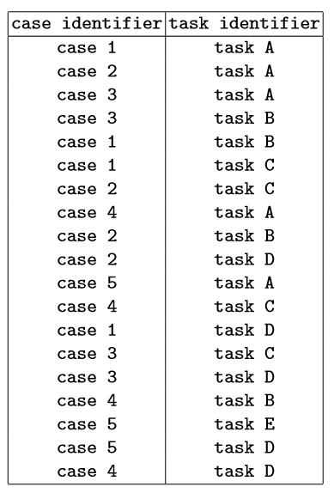
Mining configuration guidelines
Combined approach using event logs
We propose to use a suffix tree to mine configuration guidelines:
A tree-like data structure for solving problems involving strings
Allows the storage of all substrings of a given string in linear space
provides linear-time solutions for string pattern matching problems
case 1: ABCD
case 2: ACBD
…
A
D
B
C
2
2
2
2
BCD
CBD
D
BD
D
ABCDACBD
CD
1
1
1
1
1
1

Slide 105
Mining configuration guidelines
Combined approach using event logs
1. Build the frequency suffix tree
abczdef
cbzdfe
abcz …
frequency
suffix tree
2. Compute the frequency of configurations using statistical theory.
3. Rank the corresponding configurations based on their computed frequency ratio

Slide 106
Accuracy
SAP
S>0.8
Configuration guidelines
S>0.5
Relevant
Generated
VP1 | VP2 | VP3
a | b | c
a’ | b | c’
VP1 | VP2 | VP3
a | b | c’
a | b | c’

